Slide 1
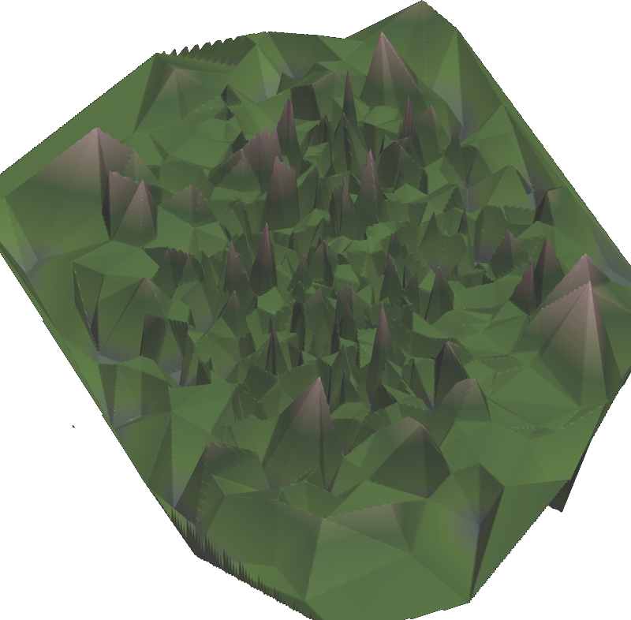
Improving model-based software synthesis
A Focus on Mathematical Structures
Andrés Goens
Chair for Compiler Construction
Center for Advancing Electronics Dresden
TU Dresden andres.goens@tu-dresden.de
Ph.D. Defense
April 30, 2021

Slide 2
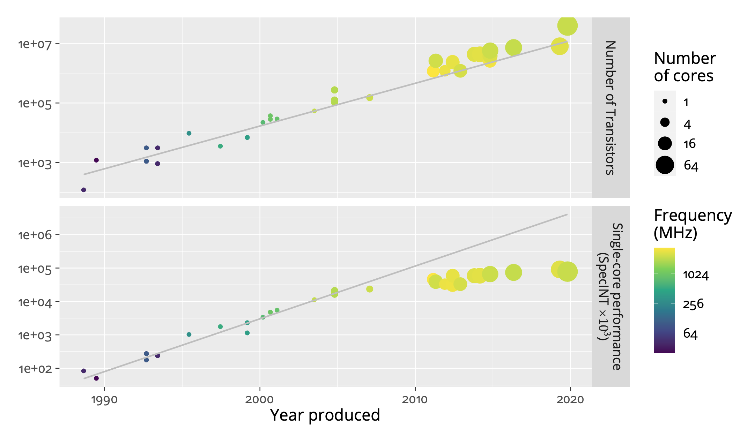
The slide we’ve all seen (“Moore’s Law”)
[Data: https://github.com/karlrupp/microprocessor-trend-data]

Slide 3



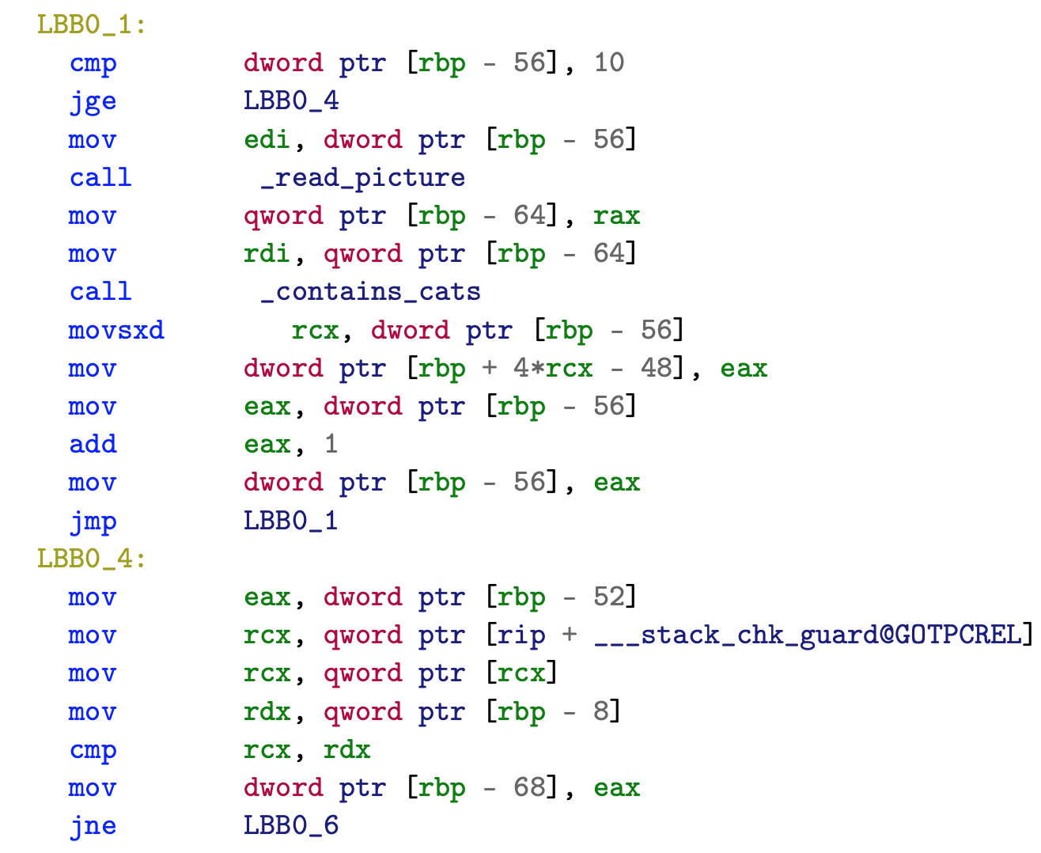



Difficulties Programming
Example: sorting out pictures with cats
Human: “look through those pictures and sort out the ones that have cats”.
x86:

Slide 4
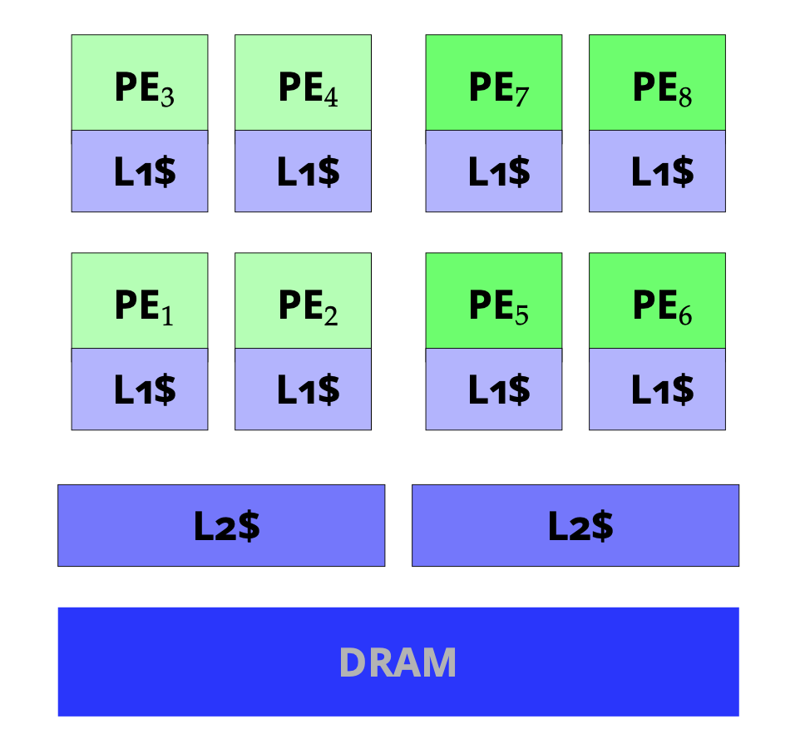
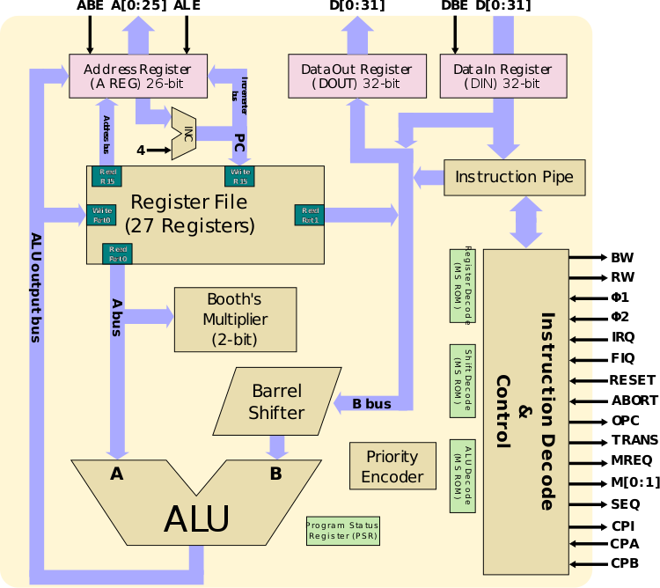
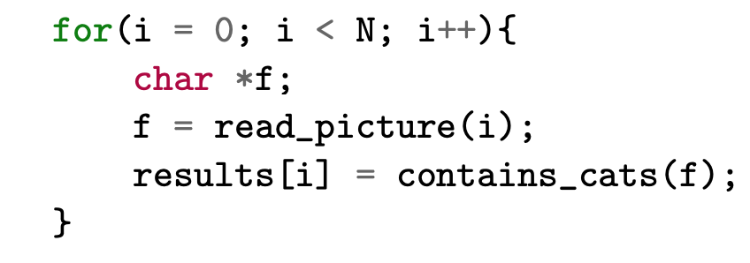
Difficulties Programming (contd.)
Programming languages: abstraction (e.g. C)
Higher-level: more abstraction (e.g. Haskell)
Dataflow:
✔️
?
Specified order:
sequential
ARM2 (1986)
Exynos 5422 (2014) ARM big.LITTLE
Order unspecified:
concurrent
read_picture
contains_cats

Slide 5
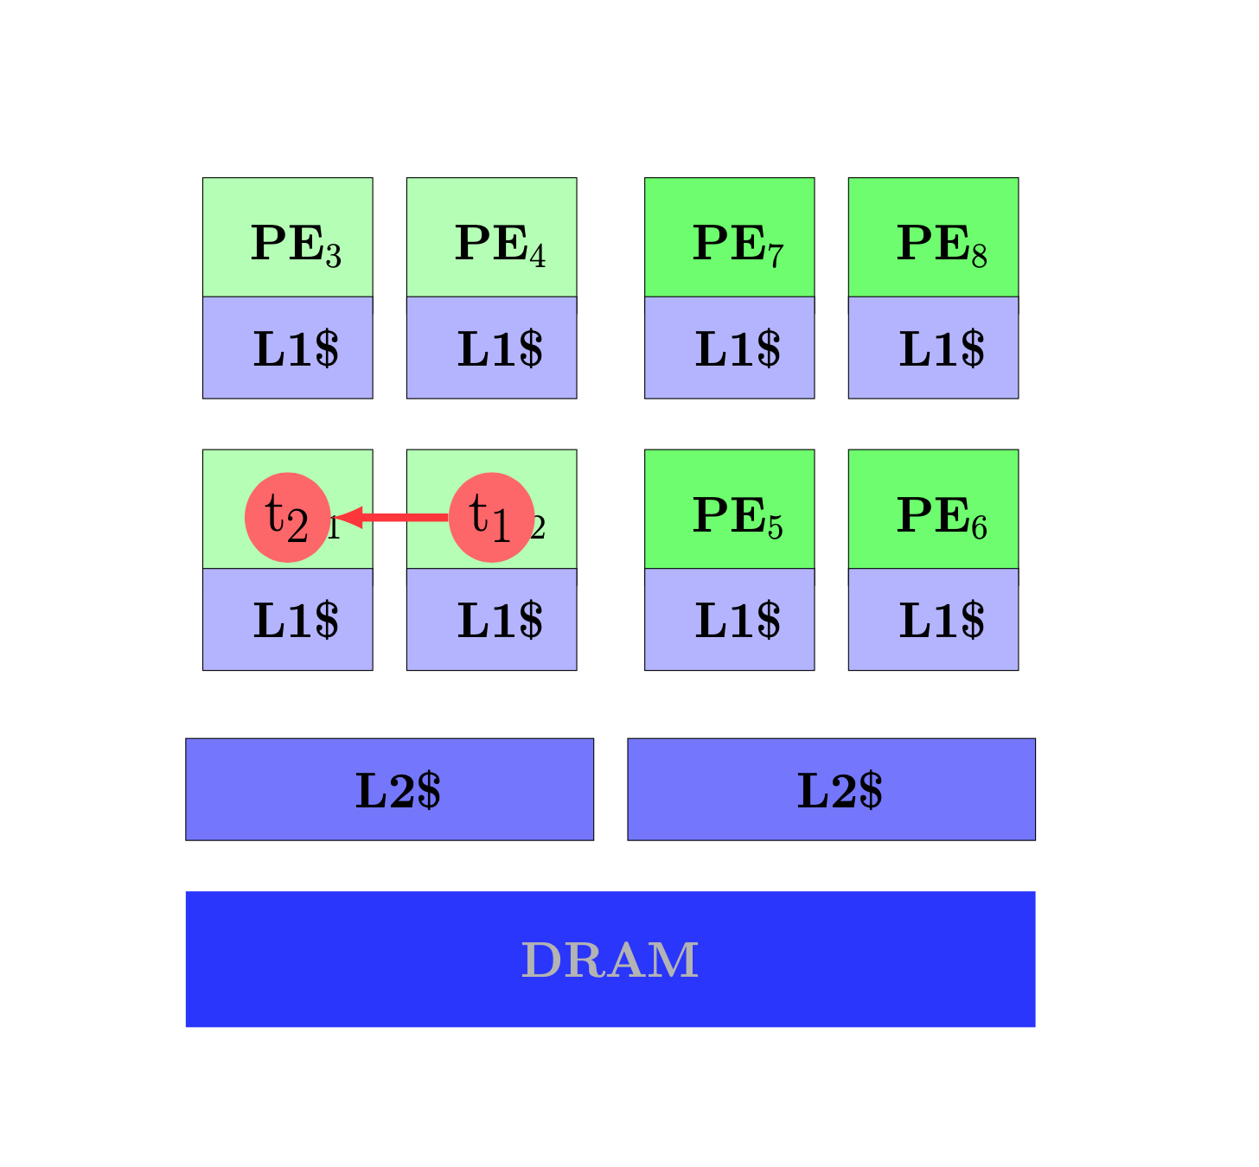
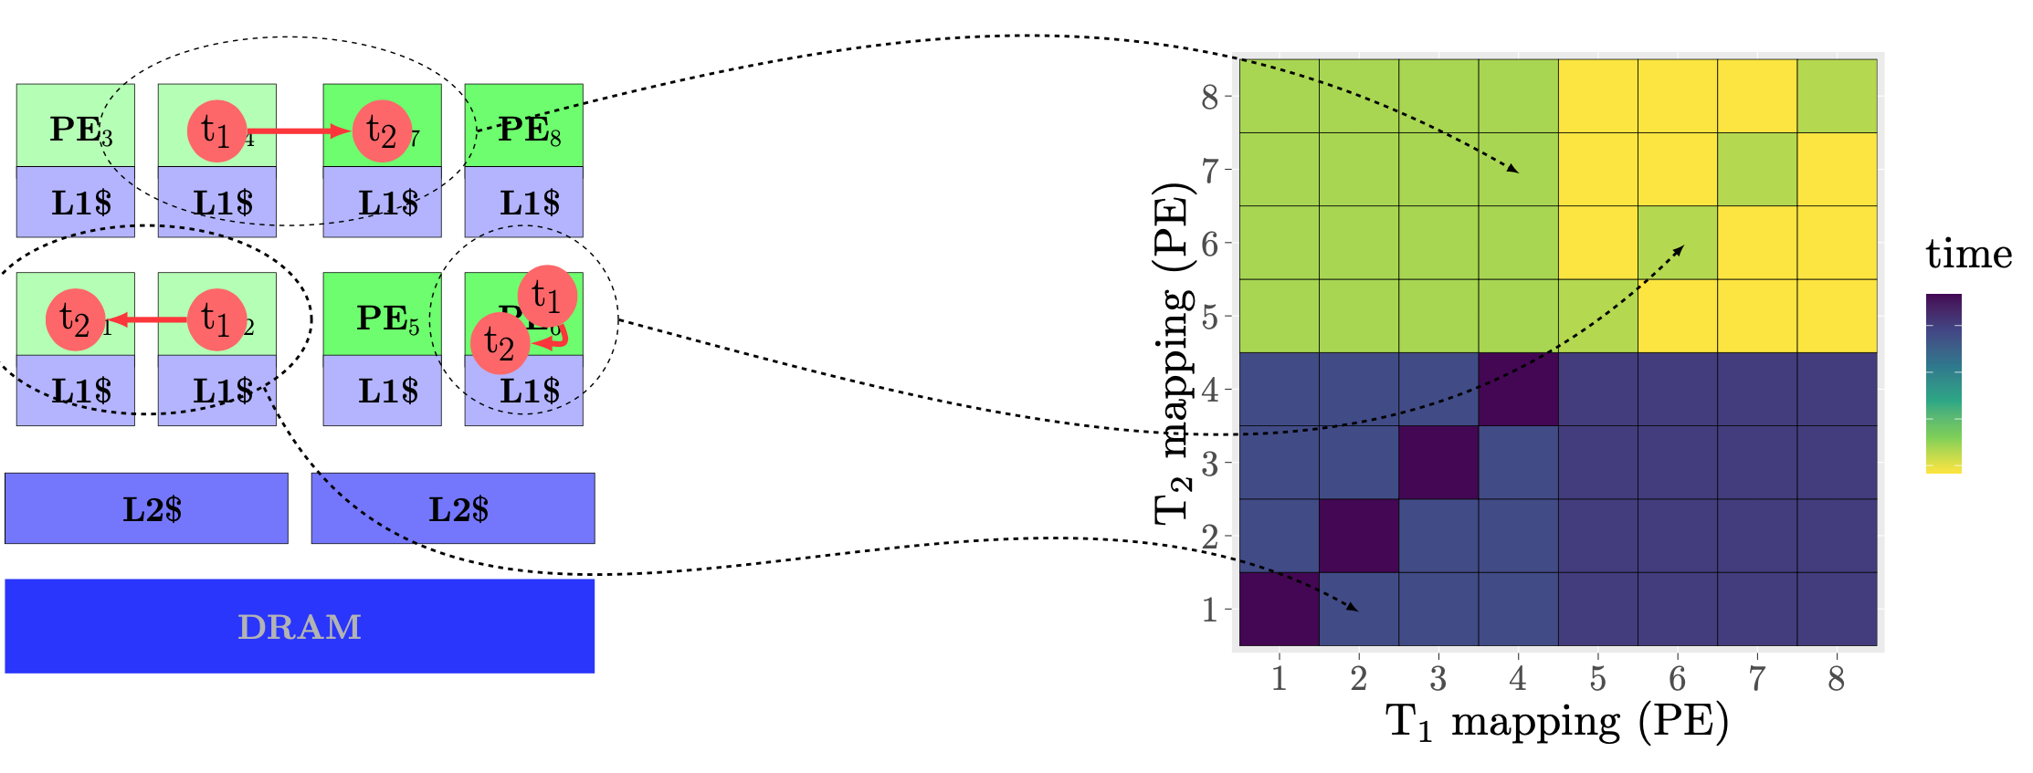
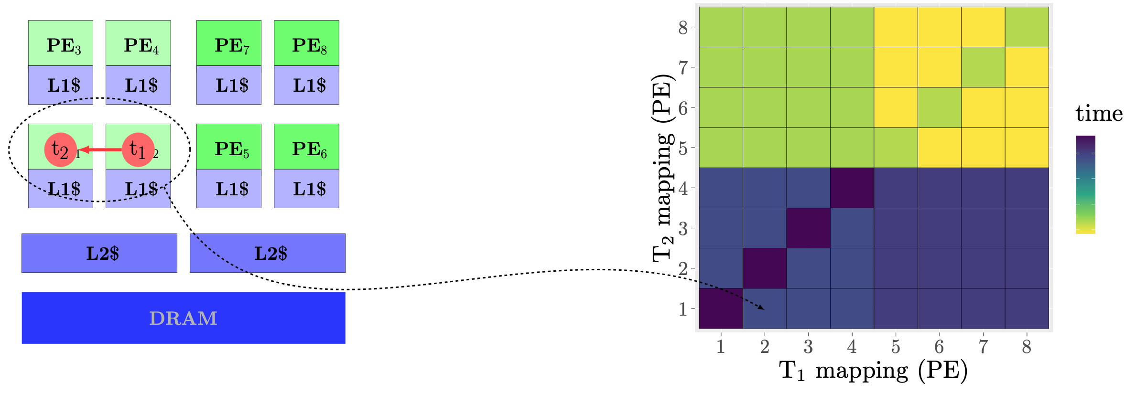
Mappings

Slide 6
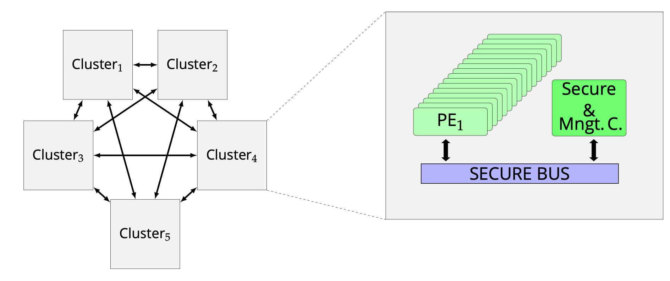
Mapping Problem: Scaling
Architecture complexity
Nominally: |mappings| = |cores|^{|tasks|}
Example: Mapping 41 processes to MPPA3 Coolidge: ~10⁷⁹ pos.
around the number of atoms in the (observable) universe!
[source: https://en.wikichip.org /wiki/acorn/microarchitectures/arm2]
Exynos 5422 (2014) ARM big.LITTLE
Kalray MPPA3
Coolidge (2020)
ARM2 (1986)

Slide 7
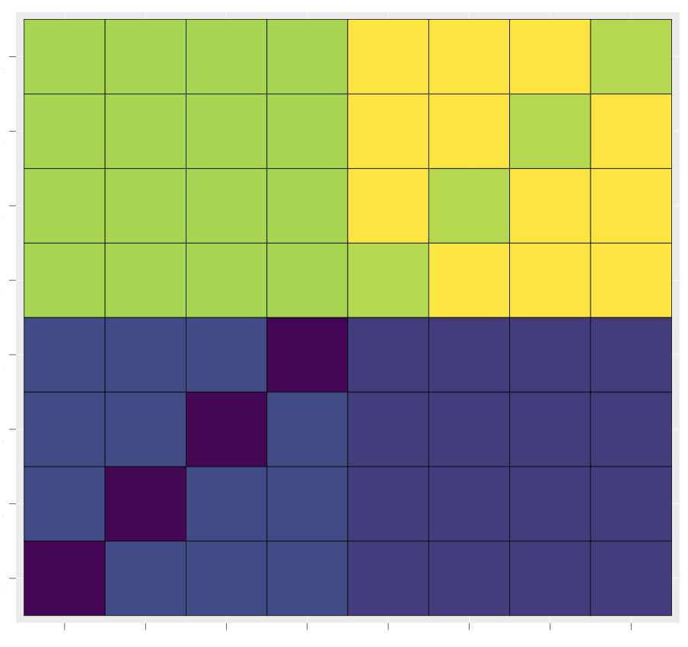
Mapping Space Structure
State of the art:
gap*
Heuristics
*mostly
Meta-heuristics
Proposed Extensions

Slide 8
Contributions/Outline
Software Synthesis + Structures in Mappings
Symmetries
Mapping Representations + Design-Space Exploration
Metric Spaces
Reactors

Slide 9
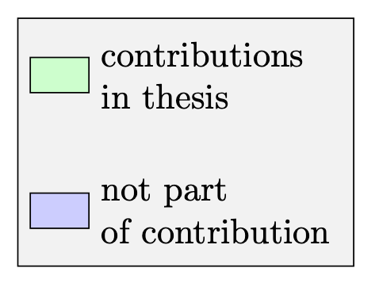
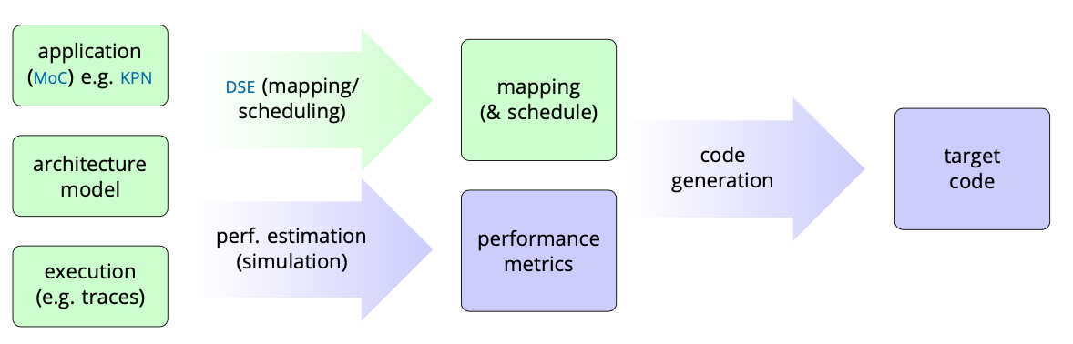
Software Synthesis
Inspired by hardware (high-level) synthesis
Software is more flexible (if we can get away with it)

Slide 10
Models of Computation (MoCs)

Slide 11
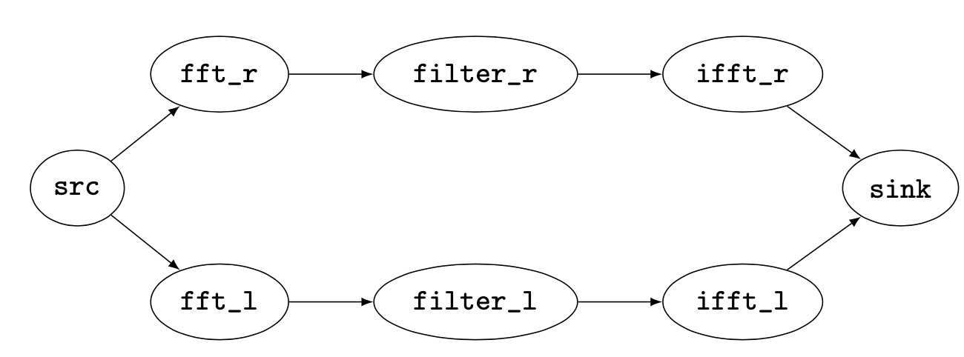
Dataflow MoCs
Models
Kahn Process Networks (KPN)
Synchronous Dataflow (SDF)
Homogeneous SDF
Properties
Concurrent
Deterministic
computation
data

Slide 12

Determinism
“a folk definition of insanity is to do the same thing over and over again and to expect the results to be different. By this definition, we in fact require that programmers of multithreaded systems be insane. Were they sane, they could not understand their programs.” [1] - Edward A. Lee
[1] Lee, Edward A. "The problem with threads." Computer 39.5 (2006): 33-42.

Slide 13
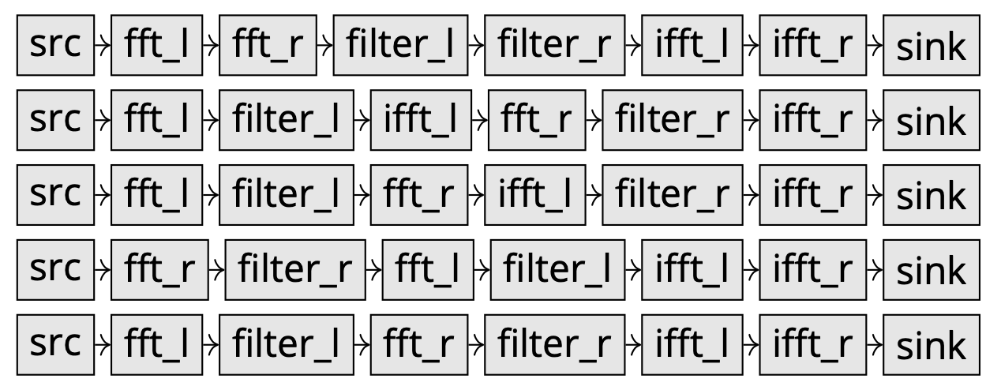
Model of Execution: Traces
What happened in the system?
Equivalent:
Mazurkievicz Traces
Histories

Slide 14
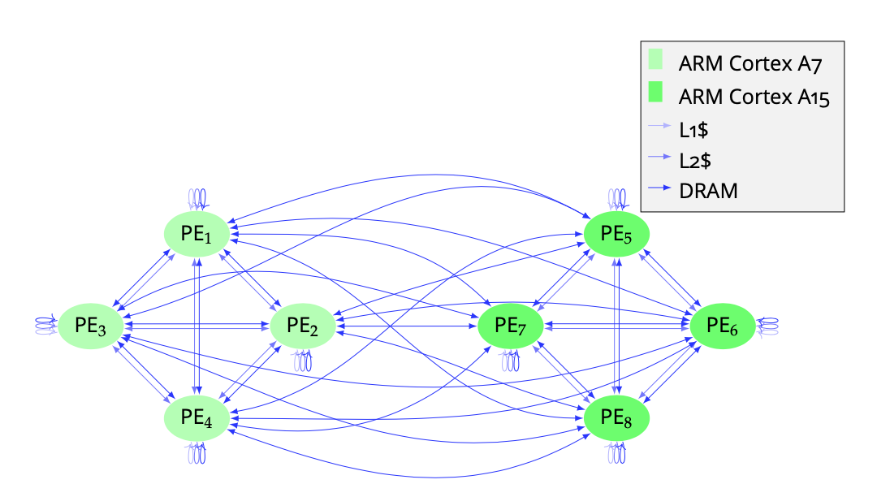
Architecture Models
Graph model: Architecture Graph A = (V_{A}, E_{A}, l_{A})
Label function: nodes with PE type, edges with communication primitive
Set of processing elements
Multiset: communication primitives

Slide 15
Contributions/Outline
Software Synthesis + Structures in Mappings
Symmetries
Mapping Representations + Design-Space Exploration
Metric Spaces
Reactors

Slide 16
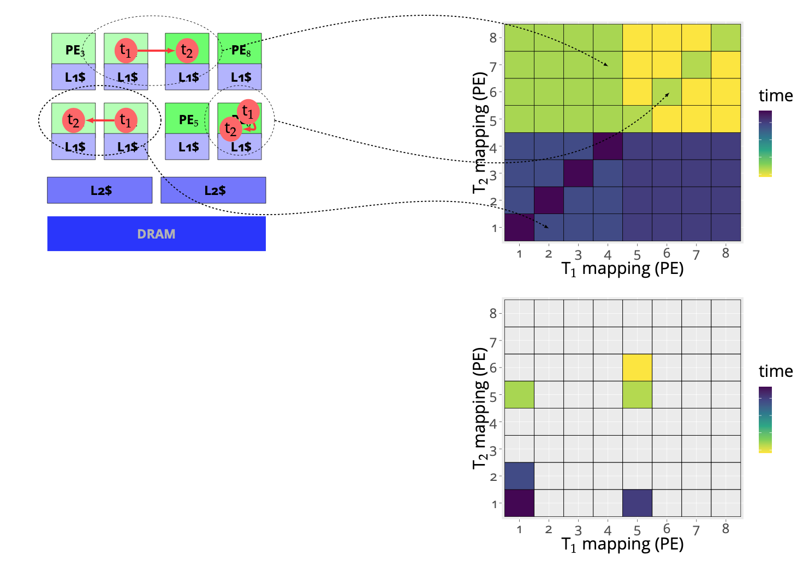
Symmetries
A lot of mappings are equivalent
This can be formally described using symmetries (group theory, inverse semigroups)
Effectively: Prune the design space
[2] Goens, A., Siccha, S., & Castrillon, J. (2017). Symmetry in software synthesis. ACM Transactions on Architecture and Code Optimization (TACO), 14(2), 1-26.

Slide 17
Architecture Symmetries
Symmetries as transformations
Cores of the same type (μarch) are interchangeable
Respect communication subsystem
Formally:
Example:
Notes:
\operatorname{Aut}(A) = \{ \sigma \in S_{V_A} \mid \\ l_A(\sigma(v)) = l_A(v) \text{ for all } v \in V_A, \\ l_A(e) = l_A(\sigma(e)) \text{ for all } e \in E_A \}

Slide 18
Mapping Symmetries
Formally:

Slide 19
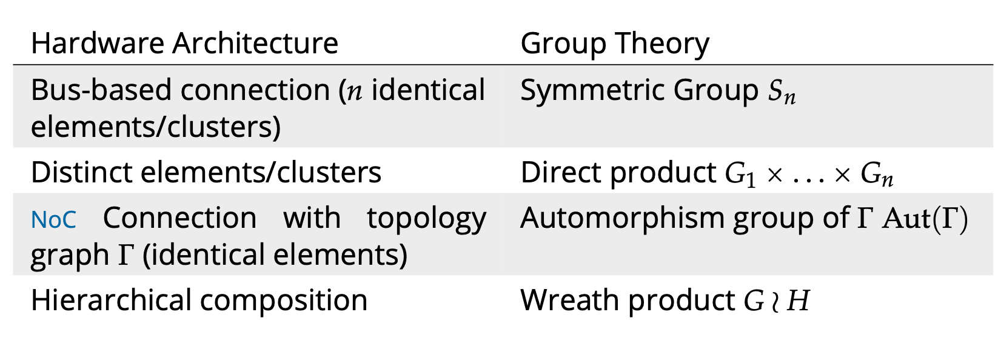
Computing the Symmetries
General case: related to graph isomorphism problem [3]
Special case for hardware architectures [4]:
[3] McKay, B. D., & Piperno, A. (2014). Practical graph isomorphism, II. Journal of Symbolic Computation, 60, 94-112.
[4] Goens, A., Nicolai, T. & Castrillon, J. (2021). mpsym: Improving Design-Space Exploration of Clustered Manycores with Arbitrary Topologies Under review.

Slide 20
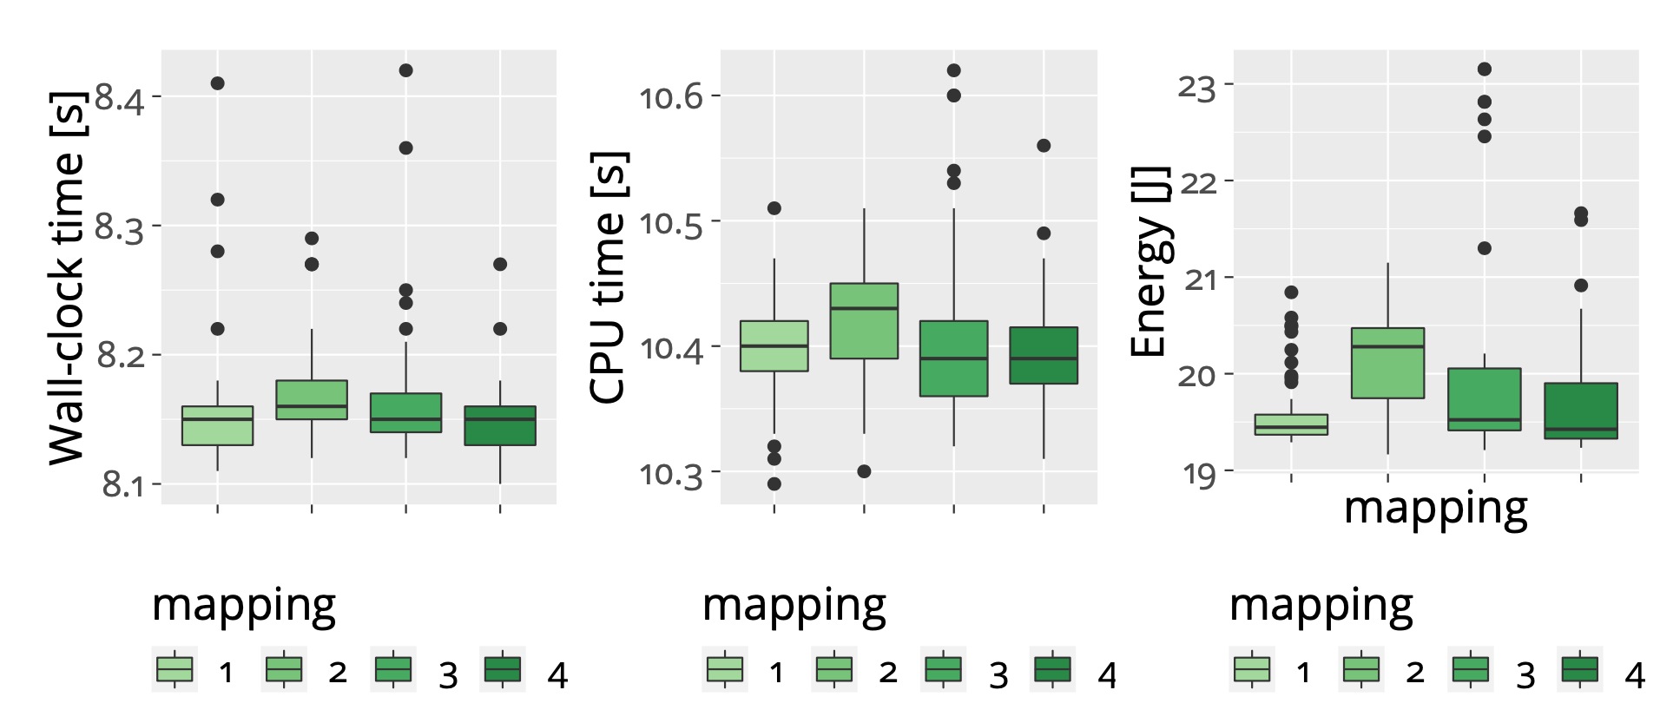
Are these really symmetries?
Measured on Odroid XU3 (Exynos 5422)
ANOVA: Exec. time variations consistent with random chance
[5] Goens, A., Khasanov, R., Hähnel, M., Smejkal, T., Härtig H. & Castrillon, J., "TETRiS: a Multi-Application Run-Time System for Predictable Execution of Static Mappings" , Proceedings of the 20th International Workshop on Software and Compilers for Embedded Systems (SCOPES'17), ACM, pp. 11–20, New York, NY, USA, Jun 2017.

Slide 21
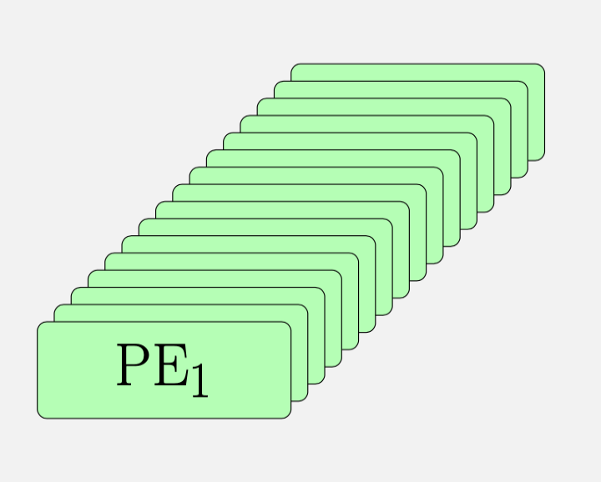
Related Work
Special case: Homogeneous Architectures [6]
Special case: NoC meshes [7-9]
[6] Thompson, M., & Pimentel, A. D. (2013). Exploiting domain knowledge in system-level MPSoC design space exploration. Journal of Systems Architecture, 59(7), 351-360.
[7] Singh, A. K., Srikanthan, T., Kumar, A., & Jigang, W. (2010). Communication-aware heuristics for run-time task mapping on NoC-based MPSoC platforms. Journal of Systems Architecture, 56(7), 242-255.
[8] Weichslgartner, A., Wildermann, S., Götzfried, J., Freiling, F., Glaß, M., & Teich, J. (2016, May). Design-time/run-time mapping of security-critical applications in heterogeneous mpsocs. In Proceedings of the 19th International Workshop on Software and Compilers for Embedded Systems (pp. 153-162).
[9] Schwarzer, T., Weichslgartner, A., Glaß, M., Wildermann, S., Brand, P., & Teich, J. (2017). Symmetry-eliminating design space exploration for hybrid application mapping on many-core architectures. IEEE Transactions on Computer-Aided Design of Integrated Circuits and Systems, 37(2), 297-310.

Slide 22
Contributions/Outline
Software Synthesis + Structures in Mappings
Symmetries
Mapping Representations + Design-Space Exploration
Metric Spaces
Reactors

Slide 23
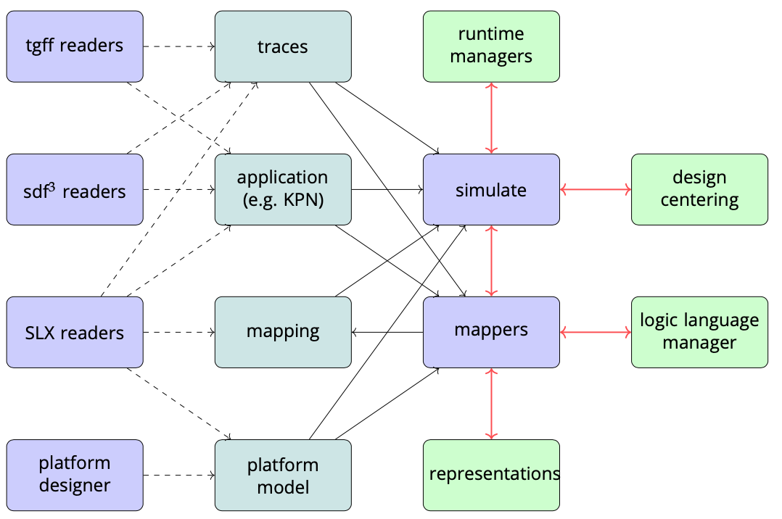
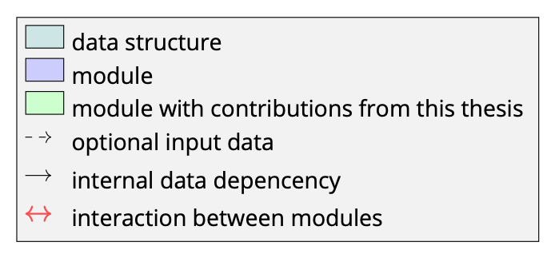
Integration: MoCasin
[10] Menard, C., Goens, A., Hempel, G., Khasanov, R., Robledo, J., Teweleitt, F., & Castrillon, J. (2021). Mocasin—Rapid Prototyping of Rapid Prototyping Tools: A Framework for Exploring New Approaches in Mapping Software to Heterogeneous Multi-cores. In Proceedings of the 2021 Drone Systems Engineering and Rapid Simulation and Performance Evaluation: Methods and Tools Proceedings (pp. 66-73).

Slide 24
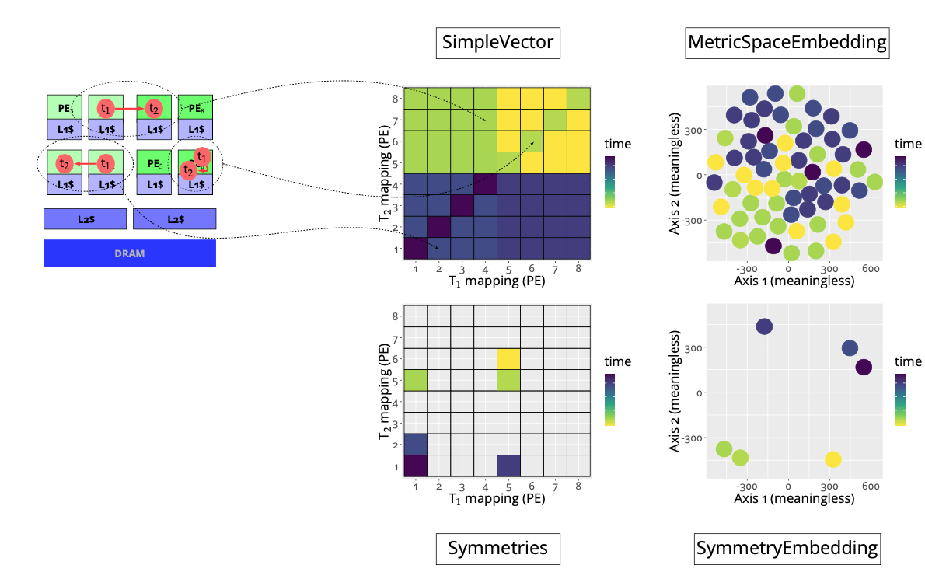
Design-space Exploration
Representation
Usages
Symmetry-aware cache
Pruning
[11] Goens, A., Menard, C., & Castrillon, J. (2018, September). On the representation of mappings to multicores. In 2018 IEEE 12th International Symposium on Embedded Multicore/Many-core Systems-on-Chip (MCSoC) (pp. 184-191). IEEE.

Slide 25
Evaluation
Using mocasin
Two benchmark suites:
CPN/MAPS[2]
Embedded System System Synthesis Benchmark Suite (E3S) [3]
[1] Jeronimo Castrillon, Rainer Leupers, and Gerd Ascheid. "MAPS: Mapping concurrent dataflow applications to heterogeneous MPSoCs." IEEE Transactions
on Industrial Informatics 9.1 (2011): 527-545.
[2] http://ziyang.eecs.umich.edu/~dickrp/e3s/

Slide 26
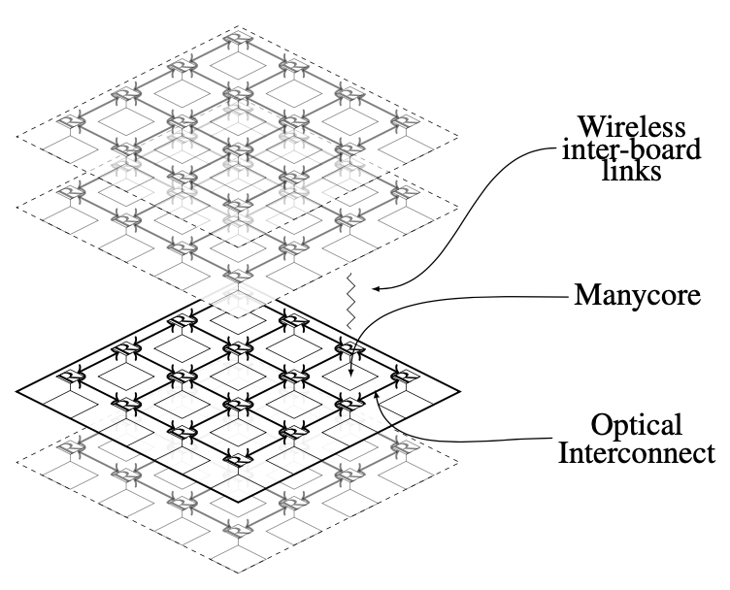
Evaluation (contd.)
4 Architecture topologies
Exynos 5422 (Odroid XU4)
Simple cluster (2 clusters w/2 cores each)
Kalray MPPA3 Coolidge
Highly Adaptive Energy-efficient Computing (HAEC) [1]
[1] Fettweis et al., "Architecture and Advanced Electronics Pathways Toward Highly Adaptive Energy-Efficient Computing" , In Proceedings of the IEEE, vol. 107, no. 1, pp. 204–231, Jan 2019.

Slide 27
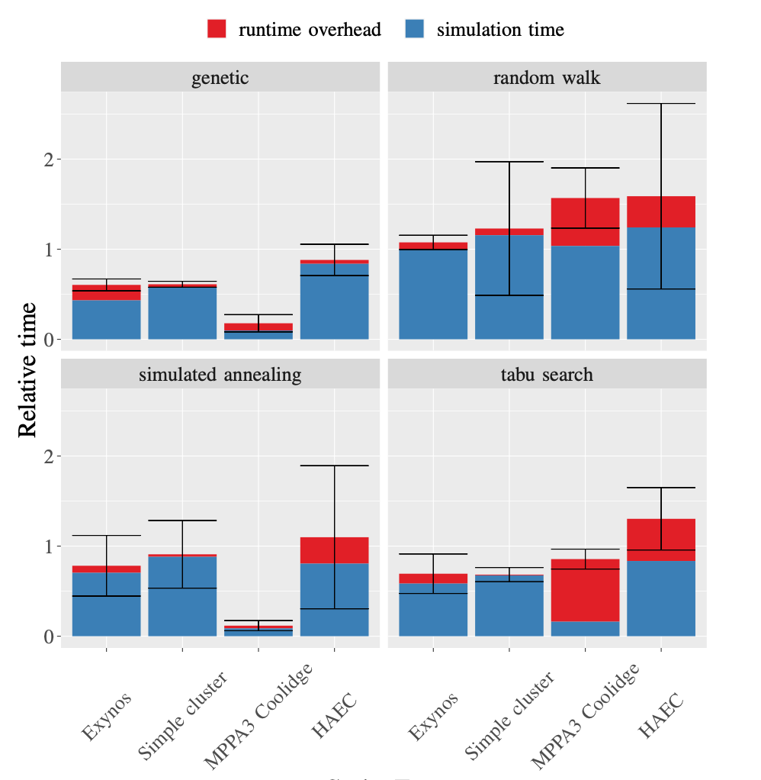
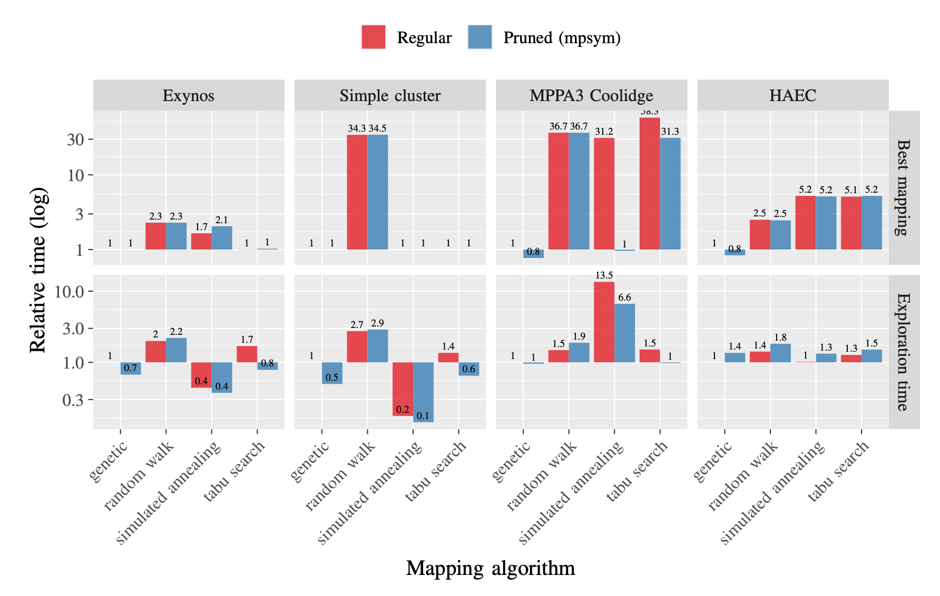
Results
Symmetry-aware cache
Pruning
[4] Goens, A., Nicolai, T. & Castrillon, J. (2021). mpsym: Improving Design-Space Exploration of Clustered Manycores with Arbitrary Topologies Under review.

Slide 28
Run-time Approach: TETRiS

Slide 29
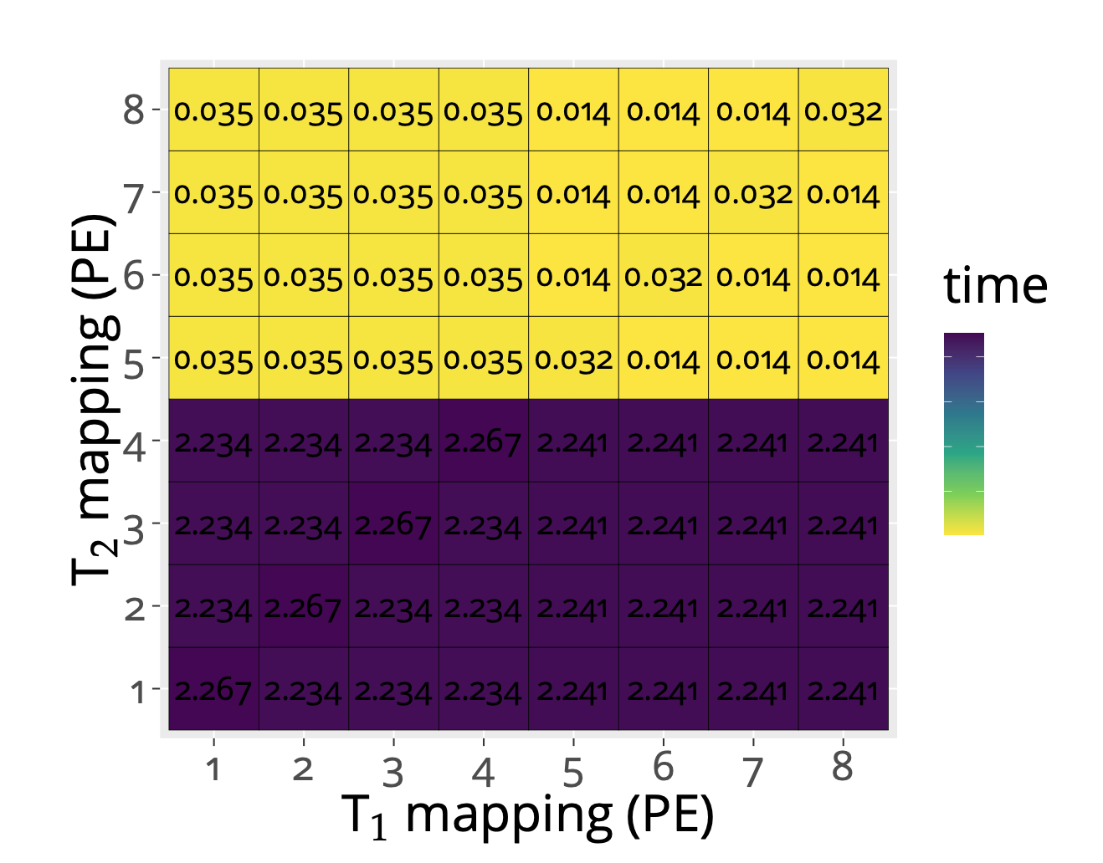
Limitations
Computational complexity/tradeoff
Some Network-on-Chip topologies (but, is this really a problem?) [12]
Symmetry breaking
Process variation, thermal effects, etc
Peripherials
High-level model (abstract)
Reality: approximate symmetries (similarities)
[12] Goens, A., Menard, C., & Castrillon, J. (2019, July). On Compact Mappings for Multicore Systems. In International Conference on Embedded Computer Systems (pp. 325-335). Springer

Slide 30
Contributions/Outline
Software Synthesis + Structures in Mappings
Symmetries
Mapping Representations + Design-Space Exploration
Metric Spaces
Reactors

Slide 31
Other Structures: Metric Spaces
[13] Goens, A & Castrillon, J. (2021). The Geometry of The Space of Task Mappings to Multicore Systems. Under Review.

Slide 32
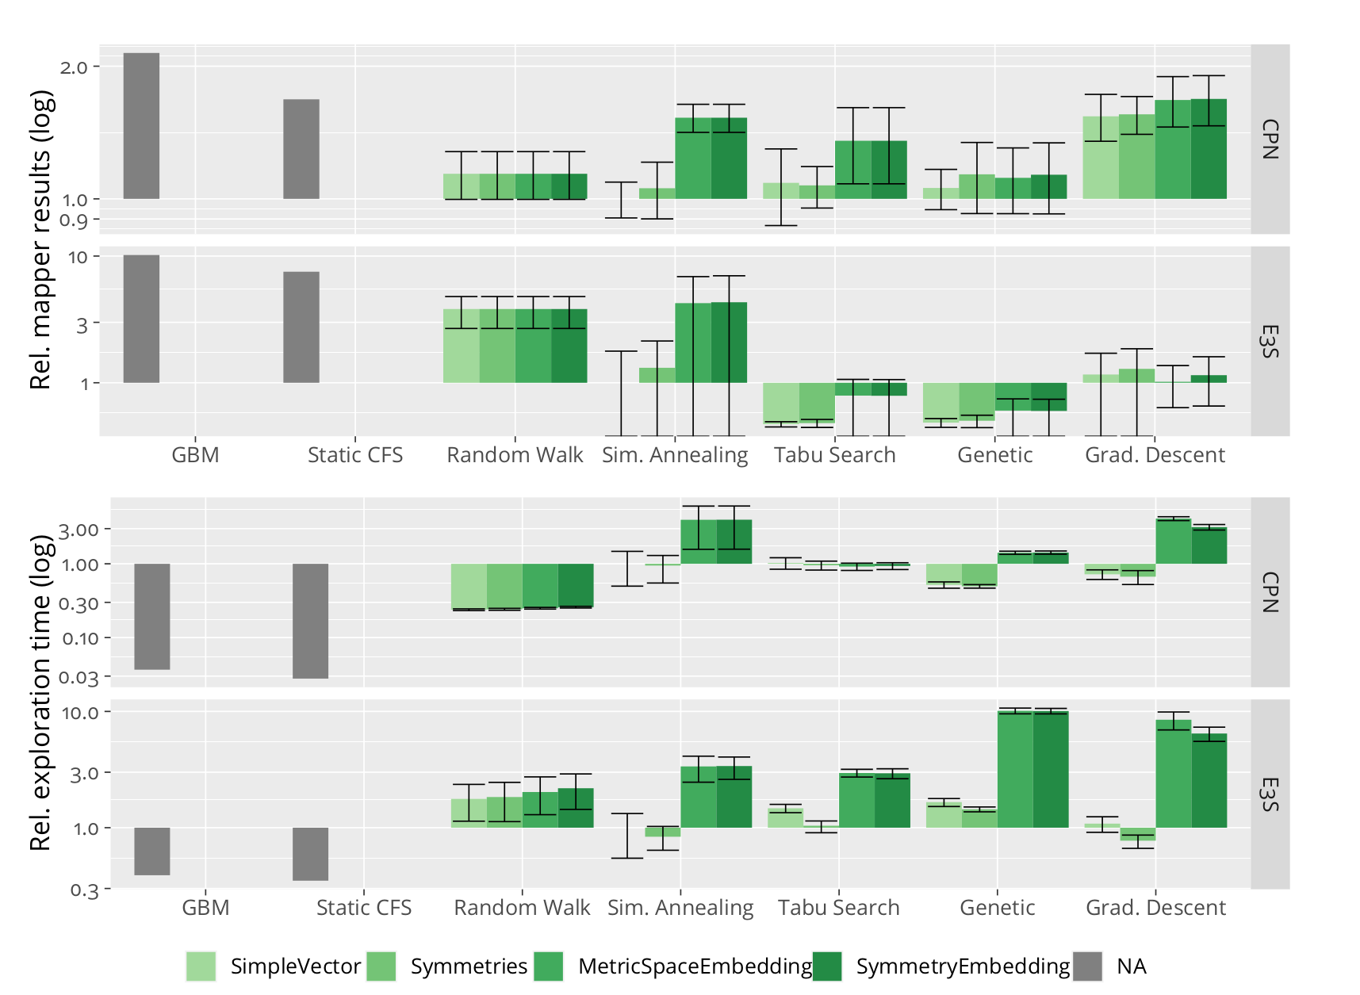
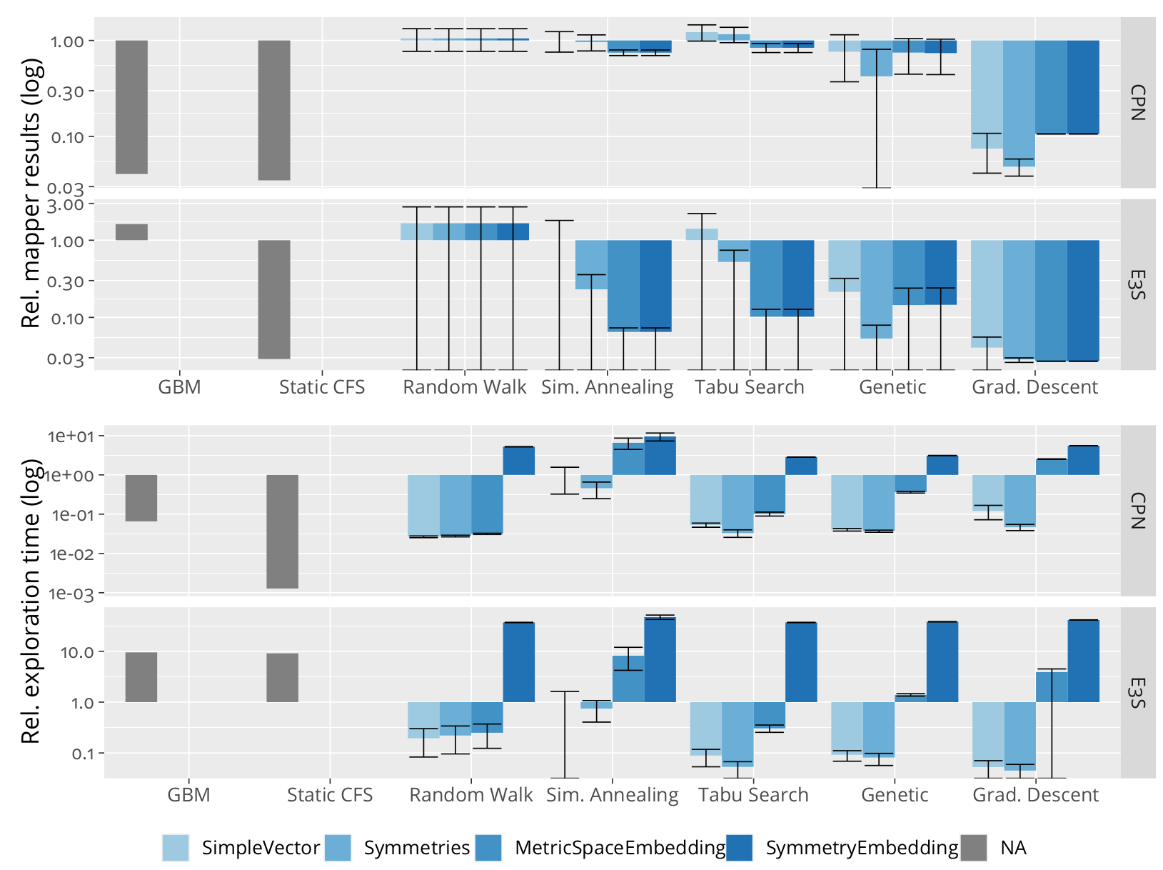
Results
Odroid XU3
MPPA3 Coolidge

Slide 33
Contributions/Outline
Software Synthesis + Structures in Mappings
Symmetries
Mapping Representations + Design-Space Exploration
Metric Spaces
Reactors

Slide 34
Models of Computation: Revisited

Slide 35
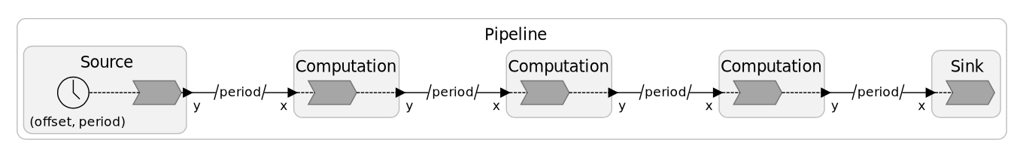
Reactors
Based on actor model [3]
Timed, concurrent & deterministic [2]
[14] Lohstroh, M., Menard, C., Bateni, S. & Lee, E. A.. (2021). Toward a Lingua Franca for Deterministic Concurrent Systems . To appear in ACM Transactions in Embedded Computing Systems.
[15] Lohstroh, M., Romeo, Í. Í., Goens, A., Derler, P., Castrillon, J., Lee, E. A., & Sangiovanni-Vincentelli, A. (2019). Reactors: A deterministic model for composable reactive systems. In Cyber Physical Systems. Model-Based Design (pp. 59-85). Springer, Cham.
[16] Lohstroh, M., Schoeberl, M., Goens, A., Wasicek, A., Gill, C., Sirjani, M., & Lee, E. A. (2019, June). Actors revisited for time-critical systems. In 2019 56th ACM/IEEE Design Automation Conference (DAC) (pp. 1-4). IEEE.

Slide 36

Conclusions
Models expose structure (e.g. symmetries)
We need to leverage it!
Can be good for performance, not only correctness.
➡ Focus on models
Source: https://pixy.org/5939439/

Slide 37
Thank you! Questions?

Slide 38
References
[1] Lee, Edward A. "The problem with threads." Computer 39.5 (2006): 33-42.
[2] Goens, A., Siccha, S., & Castrillon, J. (2017). Symmetry in software synthesis. ACM Transactions on Architecture and Code Optimization (TACO), 14(2), 1-26.
[3] McKay, B. D., & Piperno, A. (2014). Practical graph isomorphism, II. Journal of Symbolic Computation, 60, 94-112.
[4] Goens, A, Nicolai, T & Castrillon, J. (2021). mpsym: Improving Design-Space Exploration of Clustered Manycores with Arbitrary Topologies Under review.
[5] Goens, A., Khasanov, R., Hähnel, M., Smejkal, T., Härtig H. & Castrillon, J., "TETRiS: a Multi-Application Run-Time System for Predictable Execution of Static Mappings" , Proceedings of the 20th International Workshop on Software and Compilers for Embedded Systems (SCOPES'17), ACM, pp. 11–20, New York, NY, USA, Jun 2017.
[6] Thompson, M., & Pimentel, A. D. (2013). Exploiting domain knowledge in system-level MPSoC design space exploration. Journal of Systems Architecture, 59(7), 351-360.
[7] Singh, A. K., Srikanthan, T., Kumar, A., & Jigang, W. (2010). Communication-aware heuristics for run-time task mapping on NoC-based MPSoC platforms. Journal of Systems Architecture, 56(7), 242-255.
[8] Weichslgartner, A., Wildermann, S., Götzfried, J., Freiling, F., Glaß, M., & Teich, J. (2016, May). Design-time/run-time mapping of security-critical applications in heterogeneous mpsocs. In Proceedings of the 19th International Workshop on Software and Compilers for Embedded Systems (pp. 153-162).
[9] Schwarzer, T., Weichslgartner, A., Glaß, M., Wildermann, S., Brand, P., & Teich, J. (2017). Symmetry-eliminating design space exploration for hybrid application mapping on many-core architectures. IEEE Transactions on Computer-Aided Design of Integrated Circuits and Systems, 37(2), 297-310.
[10] Goens, A., Menard, C., & Castrillon, J. (2018, September). On the representation of mappings to multicores. In 2018 IEEE 12th International Symposium on Embedded Multicore/Many-core Systems-on-Chip (MCSoC) (pp. 184-191). IEEE.
[11] Menard, C., Goens, A., Hempel, G., Khasanov, R., Robledo, J., Teweleitt, F., & Castrillon, J. (2021). Mocasin—Rapid Prototyping of Rapid Prototyping Tools: A Framework for Exploring New Approaches in Mapping Software to Heterogeneous Multi-cores. In Proceedings of the 2021 Drone Systems Engineering and Rapid Simulation and Performance Evaluation: Methods and Tools Proceedings (pp. 66-73).
[12] Goens, A., Menard, C., & Castrillon, J. (2019, July). On Compact Mappings for Multicore Systems. In International Conference on Embedded Computer Systems (pp. 325-335). Springer, Cham
[13] Goens, A & Castrillon, J. (2021). The Geometry of The Space of Task Mappings to Multicore Systems. Under Review.
[14] Lohstroh, M, Menard, M, Bateni, S & Lee, E. A.. (2021). Toward a Lingua Franca for Deterministic Concurrent Systems . To appear in ACM TECS..
[15] Lohstroh, M., Romeo, Í. Í., Goens, A., Derler, P., Castrillon, J., Lee, E. A., & Sangiovanni-Vincentelli, A. (2019). Reactors: A deterministic model for composable reactive systems. In Cyber Physical Systems. Model-Based Design (pp. 59-85). Springer, Cham.
[16] Lohstroh, M., Schoeberl, M., Goens, A., Wasicek, A., Gill, C., Sirjani, M., & Lee, E. A. (2019, June). Actors revisited for time-critical systems. In 2019 56th ACM/IEEE Design Automation Conference (DAC) (pp. 1-4). IEEE.

Slide 39
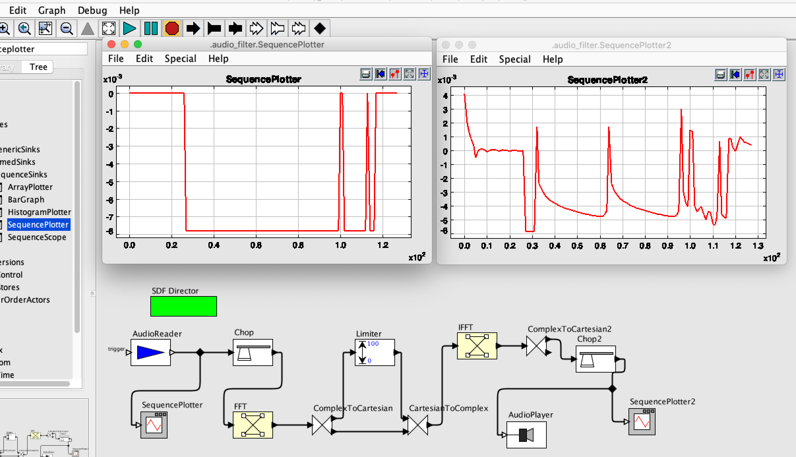
Backup: Ptolemy II
Multiple MoCs
Focus on Semantics
No DSE

Slide 40
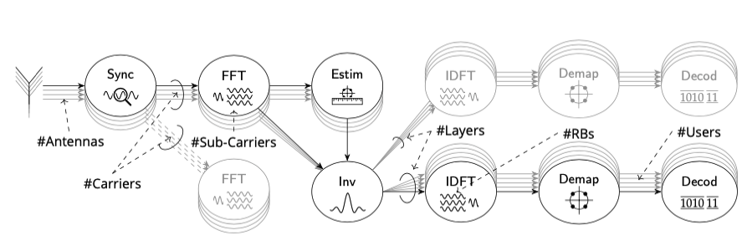
Backup: 5G Use case
Reactors
TETRiS (WiP)

Slide 41
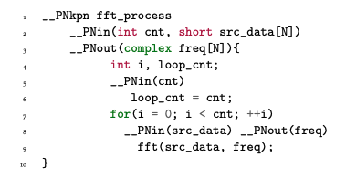

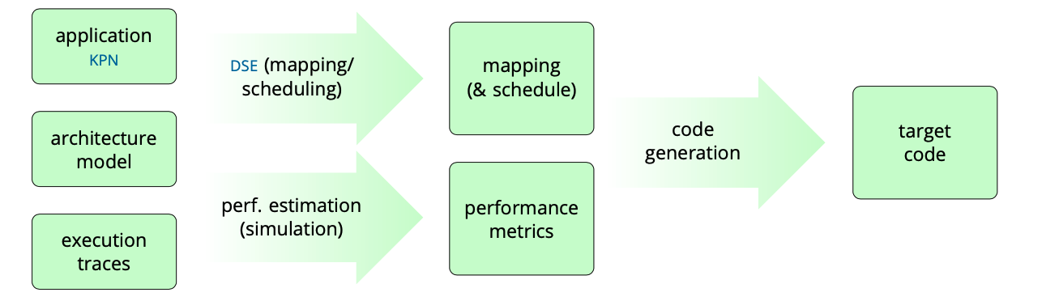
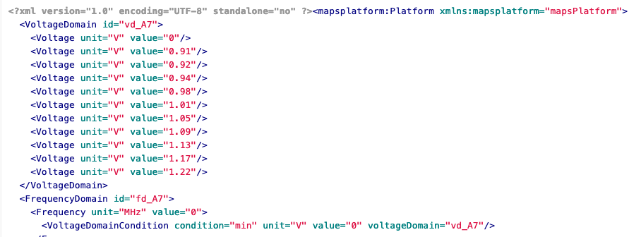
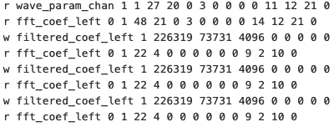
Backup: MAPS/SLX

Slide 42
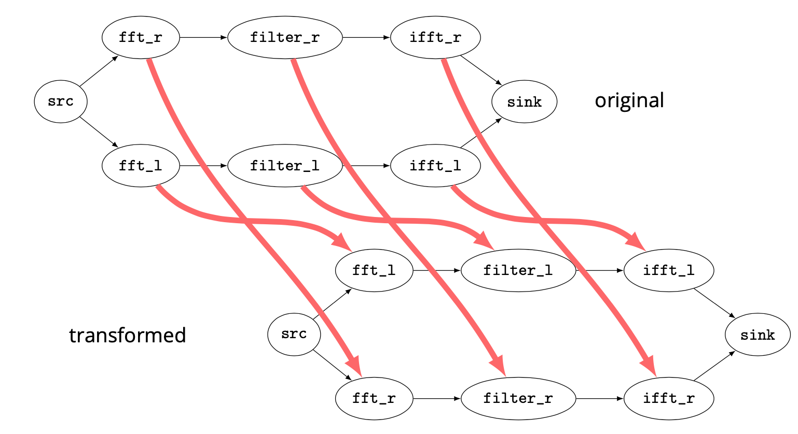
Backup: Application Symmetries
Same for applications
Careful: identical code does not mean symmetry
Safe symmetry: DLP

Slide 43
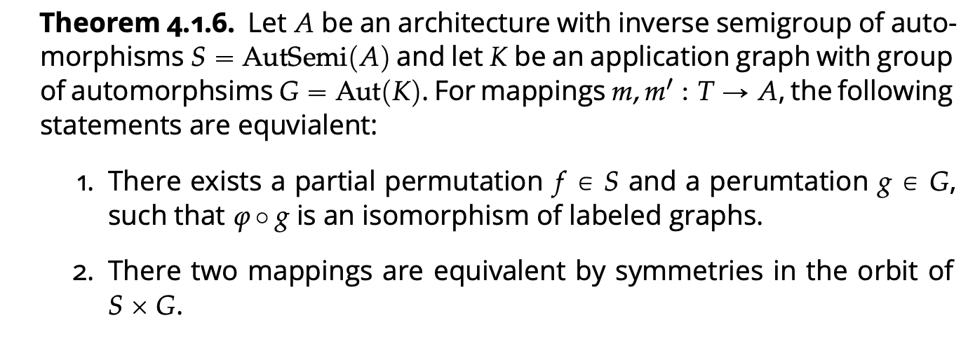
Backup: Partial Symmetries
Groups: global symmetries. Is that all?
Partial symmetries: inverse semigroups

Slide 44
Backup: Action on Mappings
Groups (global symmetries)
Inverse Semigroups (partial symmetries)

Slide 45
Backup: Intuition Symmetries
Application (task graph)
Not equivalent mappings
Equivalent mappings
dist = 1
dist = 2

Slide 46
Backup: Formalism (Groups)
Which transformations leave the structure unchanged?
Do nothing
Rotate
Reflect
Combine any of the above
A total of 8 different transformations (Dihedral group D₈)

